Slide 1
INTRODUCTION
TO
COBOL

Slide 2
Introduction
COBOL (Common Business Oriented Language) is the most widely used programming language in the world.
  Its popularity stems from its self documenting English-like statements
  USES
  It has the ability to produce large reports.
  It has the capabilities for extensive file processing
  It has the ability to handle large volumes of data efficiently

Slide 3
Reference Format for Source
TANDEM
Default and no restriction
ANSI
Sequence Number – stores line number
Indicator Area – type of information on the line ( Compiler Directive, Comment, Continuation etc)
Area A – Division names, Section/Paragraph header should begin in this area.
Area B – Sentences with paragraphs should begin here
Identification field – For comments
1
2
3
4
5
6
7
8
9
10
11
12
13
…
72
73
…
80
Area A
Sequence Number Area
Indicator Area
Area B
Identification Field

Slide 4
Data Structures
LEVEL
Starts from 01 to 49 inclusive with the below exceptions
66 – RENAME clause assigns a new name to an item or two or more items in a record.
77 – cannot be subdivided and are not sub divisions of others
88 – condition name entries
It has fixed values which can be tested .
RECORDS
Physical and Logical records
Record elements
Record length

Slide 5
Identification Division
Identifies a program
One mandatory and five optional paragraphs
IDENTIFICATION DIVISION.
PROGRAM-ID. COBSRC.
AUTHOR. MY NAME
INSTALLATION. HEADOFFICE
DATE-WRITTEN. JANUARY 20, 2010
DATE-COMPILED. JANUARY 21, 2010
SECURITY. CONFIDENTIAL

Slide 6
Environment Division
Configuration Section
Information of the system like source computer, object, special names etc
CONFIGURATION SECTION.
SOURCE-COMPUTER. TANDEM/16.
OBJECT-COMPUTER. TANDEM/16.
SPECIAL-NAMES.
FILE “$SYSTEM.SYSTEM.COBOLLIB“ IS COBOLLIB,
FILE “$SYSTEM.SYSTEM.TALLIB” IS TALLIB,
FILE “$DATA03.ACIUTILS.UTILB“ IS UTILIB.

Slide 7
Environment Division
Input-Output Section
  File Control
File organization and accesses
INPUT-OUTPUT SECTION.
FILE-CONTROL.
SELECT INFILE
ASSIGN TO "$DATA01.COBSRC.ABC"
ORGANIZATION IS SEQUENTIAL
ACCESS MODE IS SEQUENTIAL.

Slide 8
Select Clause : defines a file name that can be later used in the source program to refer the file.
Assign Clause : file name is associated to physical file .
Organization Clause :
Sequential
Relative
Indexed
Queue
Access Mode Clause :
Sequential
Random
Dynamic

Slide 9
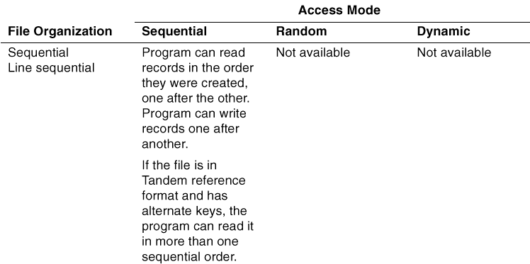
Data Structures
Relationship between Organization and Access mode
Notes:
A sequential file is organized so that each record except the first has a unique
predecessor record and each record except the last has a unique successor record.
An indexed file is organized as a set of records uniquely identified by the values of their
prime record key, a data item defined within each logical record of the file. A program
can select any record for an operation by providing the value of its prime record key.
A relative file is organized as a sequence of record areas, each capable of holding a
logical record. The successive record areas are uniquely identified by successive
integer values (called relative record numbers), beginning with one for the first record
area.
A queue file is an indexed file (and therefore, a key-sequenced file) that can function
as a queue. Processes can queue and dequeue records in a queue file. The prime key for a queue file includes an 8-byte timestamp; you
can add a user key if desired.
ACCESS MODE – manner in which the records of the file are manipulated

Slide 10
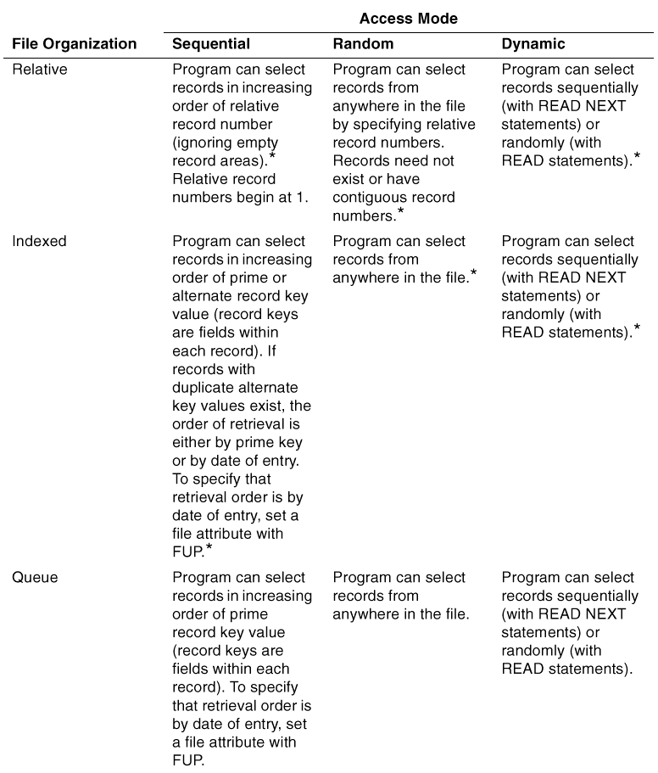
Data Structures
Notes:
A sequential file is organized so that each record except the first has a unique
predecessor record and each record except the last has a unique successor record.
An indexed file is organized as a set of records uniquely identified by the values of their
prime record key, a data item defined within each logical record of the file. A program
can select any record for an operation by providing the value of its prime record key.
A relative file is organized as a sequence of record areas, each capable of holding a
logical record. The successive record areas are uniquely identified by successive
integer values (called relative record numbers), beginning with one for the first record
area.
A queue file is an indexed file (and therefore, a key-sequenced file) that can function
as a queue. Processes can queue and dequeue records in a queue file. The prime key for a queue file includes an 8-byte timestamp; you
can add a user key if desired.
ACCESS MODE – manner in which the records of the file are manipulated

Slide 11
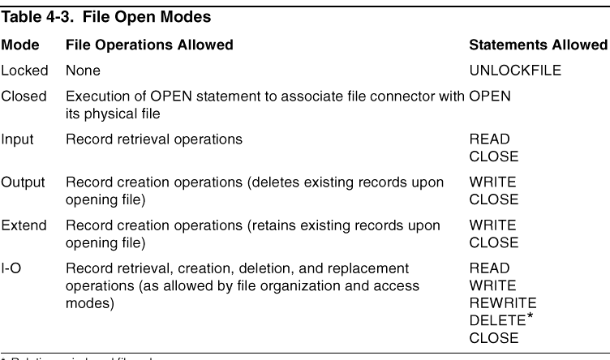
Data Structures
    OPEN MODE ( dynamic)
Notes:
A sequential file is organized so that each record except the first has a unique
predecessor record and each record except the last has a unique successor record.
An indexed file is organized as a set of records uniquely identified by the values of their
prime record key, a data item defined within each logical record of the file. A program
can select any record for an operation by providing the value of its prime record key.
A relative file is organized as a sequence of record areas, each capable of holding a
logical record. The successive record areas are uniquely identified by successive
integer values (called relative record numbers), beginning with one for the first record
area.
A queue file is an indexed file (and therefore, a key-sequenced file) that can function
as a queue. Processes can queue and dequeue records in a queue file. The prime key for a queue file includes an 8-byte timestamp; you
can add a user key if desired.
ACCESS MODE – manner in which the records of the file are manipulated

Slide 12
Data Structures
    EXCLUSION MODE
Mode
Other Process
READ
Other Process WRITE
Shared
YES
YES
Protected
YES
NO
Exclusive
NO
NO
Notes:
A COBOL program makes reference to files indirectly. It does not refer to a file by the
file’s Guardian file name. Instead, it uses an ASSIGN clause in a file-control entry in
the Input-Output Section of the Environment Division (possibly overridden at execution
time by command interpreter commands) to associate the Guardian file name with a
file connector, which is referred to throughout the remainder of the COBOL program
through a COBOL file name.

Slide 13
Environment Division
Input-Output Section
  I-O-Control
Specifies the positioning information for the sharing of a memory area by more than one file
  RECEIVE-CONTROL
$ Receive parameters for startup message
Notes:
Table – maximum number of request
Sync depth – howmany replies are stored for each request
Reply length

Slide 14
Data Division
FILE SECTION
Contains the file descriptions
FD LCONF-FILE
COPY LCONF OF "=BASRC_BADDLCOB".
WORKING STORAGE SECTION
Contains the variables and data structure used for processing
WORKING-STORAGE SECTION.
01 CURRENT-DATE.
05 CURRENT-YEAR PICTURE 99 VALUE ZERO.
05 CURRENT-MONTH PICTURE 99 VALUE ZERO.
05 CURRENT-DAY PICTURE 99 VALUE ZERO.

Slide 15
Data Division
EXTENDED STORAGE SECTION
same as working storage section however the data defined in this section is stored in the extended memory
EXTENDED-STORAGE SECTION.
01 CURRENT-DATE.
05 CURRENT-YEAR PICTURE 99 VALUE ZERO.
05 CURRENT-MONTH PICTURE 99 VALUE ZERO.
05 CURRENT-DAY PICTURE 99 VALUE ZERO.

Slide 16
Data Division
LINKAGE SECTION
specifies the data passed from the calling program to the program containing the linkage section

Slide 17
Procedure Division
Is the place we actually write the statements of code to perform a task.
  Declaratives
  Statements
  Sentences
  Paragraphs
  Sections
  Procedures
Notes:
A group of statements terminated with a period is called a sentence.
A group of sentences under one name is a paragraph
A group of paragraph under one name is section
A set of paragraph executed together can be a procedure
Declaratives portion is reserved for debugging routines and input-output errors

Slide 18
Procedure Division
PROCEDURE DIVISION.
DRIVER SECTION.
DRIVE.
PERFORM 100-INITIALIZATION
PERFORM 200-PROCESS-REQUESTS UNTIL JOB-IS-DONE
PERFORM 300-TERMINATION.
100-INITIALIZATION SECTION.
OPEN-FILES.
OPEN INPUT MESSAGE-IN
OPEN OUTPUT MESSAGE-OUT
OPEN INPUT BASE-FILE.
FINISH-UP-INIT.
MOVE "READY" TO WATCH-WORD.
...
200-PROCESS-REQUESTS SECTION.
READ-DOLLAR-RECEIVE.
READ MESSAGE-IN
...
PROCESS-INPUT-DATA.
...
300-TERMINATION SECTION.
STOP RUN.

Slide 19
Verbs
ACCEPT
delivers small amount of information to a process from terminal or other process
PROCEDURE DIVISION.
DEMO.
PERFORM UNTIL PROGRAM-CODE = 0
DISPLAY "ENTER RUN CODE" UPON USER-TERMINAL
ACCEPT PROGRAM-CODE FROM USER-TERMINAL
DISPLAY "CODE RECEIVED: "
PROGRAM-CODE UPON USER-TERMINAL
END-PERFORM.
Notes:
A group of statements terminated with a period is called a sentence.
A group of sentences under one name is a paragraph
A group of paragraph under one name is section
A set of paragraph executed together can be a procedure
Declaratives portion is reserved for debugging routines and input-output errors

Slide 20
Verbs
ADD
stores sum of 2 or more numeric values in one or more data items
ADD A B C to D E
Stores A+B+C+D in D and A+B+C+E in E
ADD A B C giving D E
Stores A+B+C in D and E
Notes:
A group of statements terminated with a period is called a sentence.
A group of sentences under one name is a paragraph
A group of paragraph under one name is section
A set of paragraph executed together can be a procedure
Declaratives portion is reserved for debugging routines and input-output errors

Slide 21
Verbs
CALL
executes the task written in another program which are binded into this executable
CALL PROC1 OF OTHEROBJ USING A B C.
PROC1 is in another program executable called OTHEROBJ and A,B,C are the paramters that are required by it.
Notes:
A group of statements terminated with a period is called a sentence.
A group of sentences under one name is a paragraph
A group of paragraph under one name is section
A set of paragraph executed together can be a procedure
Declaratives portion is reserved for debugging routines and input-output errors

Slide 22
Verbs
CLOSE
closes the files opened
CLOSE FILE1.
COMPUTE
used for arithmetic operations
COMPUTE C = A+B.
COPY
copies a source text from a file as a copy library
Notes:
A group of statements terminated with a period is called a sentence.
A group of sentences under one name is a paragraph
A group of paragraph under one name is section
A set of paragraph executed together can be a procedure
Declaratives portion is reserved for debugging routines and input-output errors

Slide 23
Verbs
DISPLAY
delivers data to terminal of other process
DISPLAY A.
ENTER
used to call routines written in other language
ENTER TAL "FILEINFO" USING OMITTED, WS-GUAR- ERR,LCONF-NAME-I
EVALUATE
Case statement for COBOL
EVALUATE A
WHEN 1 PERFORM TRAN-1
WHEN OTHER PERFORM TRAN-BAD
END-EVALUATE
Notes:
A group of statements terminated with a period is called a sentence.
A group of sentences under one name is a paragraph
A group of paragraph under one name is section
A set of paragraph executed together can be a procedure
Declaratives portion is reserved for debugging routines and input-output errors

Slide 24
Verbs
GO TO
passes control from one part of procedure to other
GO TO PROC A.
IF
validates one of the 2 condition and manages the flow
IF A = 2 THEN
MOVE
Copies and store the data to one or more variables
MOVE A TO B C
PERFORM
executes the procedures
PREFORM CHECKUP.
Notes:
A group of statements terminated with a period is called a sentence.
A group of sentences under one name is a paragraph
A group of paragraph under one name is section
A set of paragraph executed together can be a procedure
Declaratives portion is reserved for debugging routines and input-output errors

Slide 25
Verbs
READ
Copies one logical record from the file and stores in record identifier
SELECT INFILE
ASSIGN TO "$DATA01.DATA.INPUTF"
ORGANIZATION IS SEQUENTIAL
ACCESS MODE IS SEQUENTIAL
FILE STATUS IS INPUT-DATA-FILE-STATUS.
READ INFILE AT END CLOSE INFILE.
Notes:
A group of statements terminated with a period is called a sentence.
A group of sentences under one name is a paragraph
A group of paragraph under one name is section
A set of paragraph executed together can be a procedure
Declaratives portion is reserved for debugging routines and input-output errors

Slide 26
Verbs
REWRITE
updates the record read and write to file
SEARCH
scans a table for a element that satisfies the condition
STOP
halts the current run unit
Notes:
A group of statements terminated with a period is called a sentence.
A group of sentences under one name is a paragraph
A group of paragraph under one name is section
A set of paragraph executed together can be a procedure
Declaratives portion is reserved for debugging routines and input-output errors

Slide 27
Verbs
STRING
combines some characters from 2 or more data items into one.
STRING PART-1 DELIMITED BY ZERO
SPACE DELIMITED BY SIZE
PART-2 DELIMITED BY SPACE
SPACE DELIMITED BY SIZE
PART-3 DELIMITED BY SPACE
INTO RESULT-1 WITH POINTER COUNT-1
WRITE
writes the record to the file.
Notes:
A group of statements terminated with a period is called a sentence.
A group of sentences under one name is a paragraph
A group of paragraph under one name is section
A set of paragraph executed together can be a procedure
Declaratives portion is reserved for debugging routines and input-output errors

Slide 28
COMPILATION STEPS ..
TACL> COBOL85/in SRC/OBJ

Slide 29
Practicals
Welcome to COBOL
Write a program to accept you name and print it back
Write a program to ask for 2 numbers and the operator and show the result based on the operation specified
Write a program to do a add, update, delete and view into a file ( using ddl )
Notes:
A group of statements terminated with a period is called a sentence.
A group of sentences under one name is a paragraph
A group of paragraph under one name is section
A set of paragraph executed together can be a procedure
Declaratives portion is reserved for debugging routines and input-output errors

Slide 30
Thank you

